Slide 1
AI SATURDAYS LAGOS
Visualization & Data Exploration
Aseda Addai-Deseh

Slide 2








About me

Slide 3
Agenda
Why visualization matters
Use cases: exploratory data analysis, data storytelling/presentation
Data types & visualization techniques (quiz)
Visualization & presentation tools
Mini project on EDA visualization
Additional resources

Slide 4
Why Viz Matters

Slide 5
Summary Statistics
Statisticians commonly try to describe and characterize data/observations by finding:
a measure of location, or central tendency, such as the arithmetic mean
a measure of statistical dispersion like the standard mean absolute deviation
a measure of the shape of the distribution like skewness
if more than one variable is measured, a measure of statistical dependence such as a correlation coefficient
Notes:
Part of descriptive statistics
summarizes and provides a gist of information about the sample data.

Slide 6
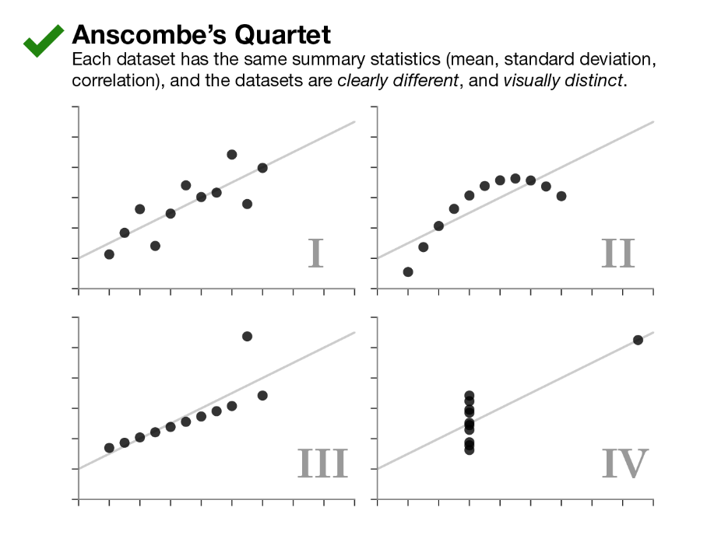
Why visualization matters
Notes:
Anscombe’s Quartet: Developed by F.J. Anscombe in 1973, Anscombe’s Quartet is a set of four datasets, where each produces the same summary statistics (mean, standard deviation, and correlation), which could lead one to believe the datasets are quite similar. However, after visualizing (plotting) the data, it becomes clear that the datasets are markedly different.
How he created his dataset is unknown and so datasaurus was created.

Slide 7
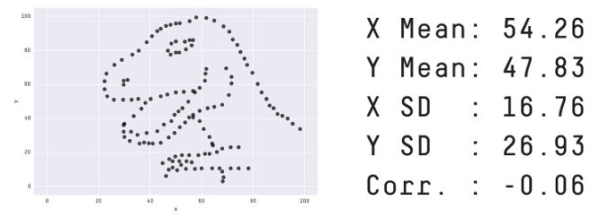
The Datasaurus
Datasaurus- https://www.research.autodesk.com/publications/same-stats-different-graphs/
Notes:
Recently, Albert Cairo created the Datasaurus dataset which urges people to “never trust summary statistics alone; always visualize your data.” While the data exhibits normal-seeming statistics, plotting the data reveals a picture of a dinosaur. Inspired by Anscombe’s Quartet and Datasaurus, we present, The Datasaurus Dozen.

Slide 8
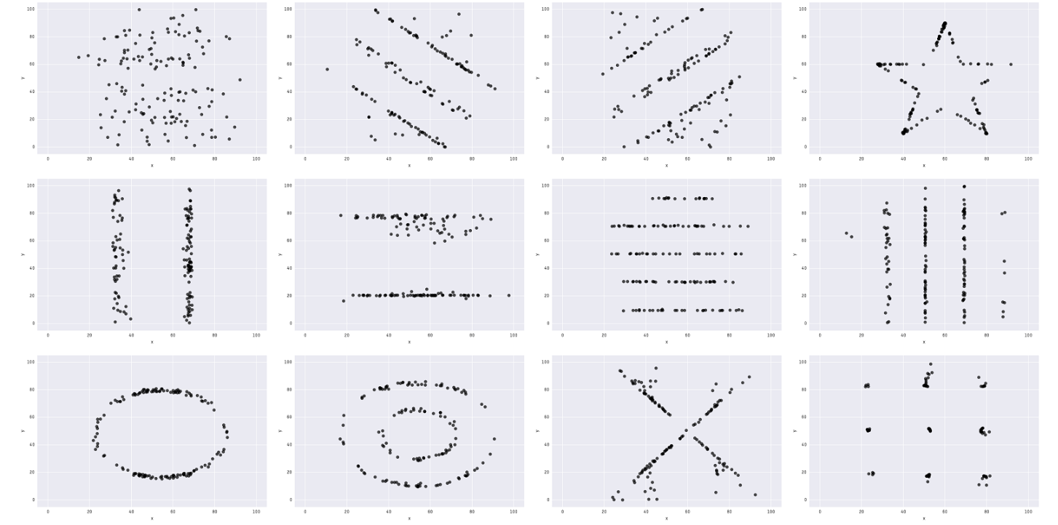
Datasaurus Dozen
Notes:
From Autodesk: The Datasaurus Dozen. While different in appearance, each dataset has the same summary statistics (mean, standard deviation, and Pearson’s correlation) to two decimal places.

Slide 9
While summary statistics helps us to explore our data we should never trust summary statistics alone; always visualize your data.

Slide 10
Data Viz Use Cases

Slide 11
Exploratory Data Analysis (EDA)
Answering questions with data
Exploring what questions to ask in data exploration
Discover the underlying structure of the data.
Look for trends, patterns, and anomalies in the data.
Could be done separate or in conjunction with data cleaning
Usually to be viewed only by the analyst and doesn’t need to be shiny
Notes:
Understanding what is true about the data
Understanding a collection of data for further analysis
Brings to bear the data stories in the data
Usually to be viewed only by the analyst and doesn’t need to be shiny
We will be doing some EDA later

Slide 12
Data Presentation
Distilling some aspect of data into easily understandable charts that convey insights
Convincing other people your findings are true
Usually for business stakeholders
Needs to be visually appealing
Usually done with a presentation software or dashboard

Slide 13
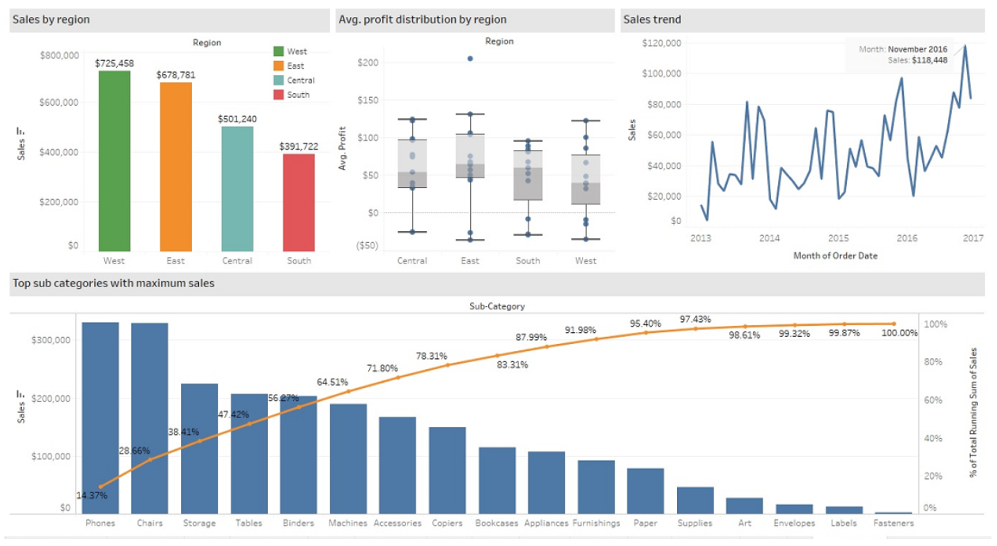
Data Presentation
Link to dashboard: https://anthonysmoak.com/2018/07/23/tableau-sales-dashboard-performance/
Notes:
Ex: Sales Performance Dashboard
Sales executives can track quarter-to-date revenue growth and evaluate statistics from the previous and current quarters using the user-friendly sales summary dashboard.
Numerous sales departments monitor growth, customize strategies, and plan future projects using year-over-year sales performance dashboards. Sales management can use this to compare the sales performance from one year to the next by business, region, and client.

Slide 14
Viz Techniques

Slide 15
Data Types
Continuous: usually numbers eg. heights, temperatures, revenues
Categorical: usually text eg. eye colors, countries, industry

Slide 16
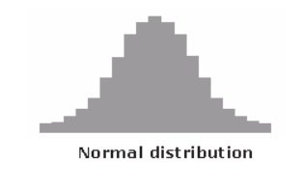
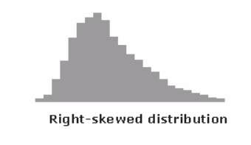
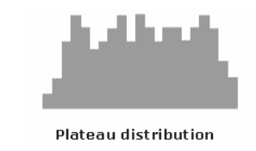
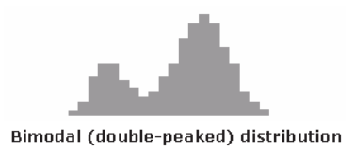
Histograms
When to use:
Visualizing single variable
The data are numerical
Seeing the shape of the data’s distribution
Read more: https://asq.org/quality-resources/histogram
Notes:
# add left skewed data

Slide 17
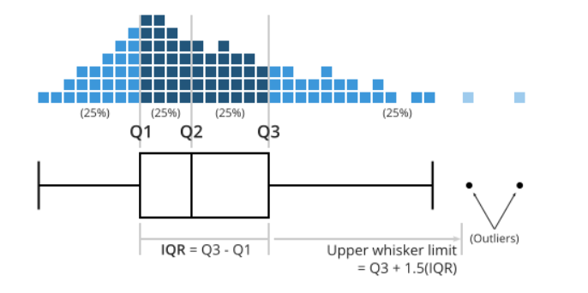
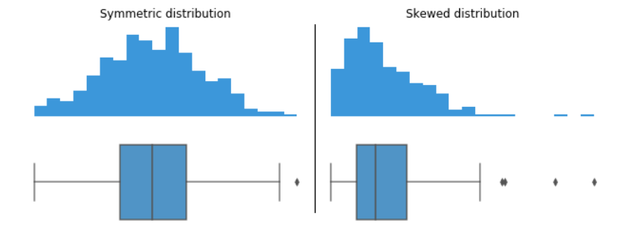
Box plots
Used to show distributions of numeric data values, especially when you want to compare them between multiple groups.
Read more: https://chartio.com/learn/charts/box-plot-complete-guide/
Notes:
Explanation of the quartiles and skewness

Slide 18
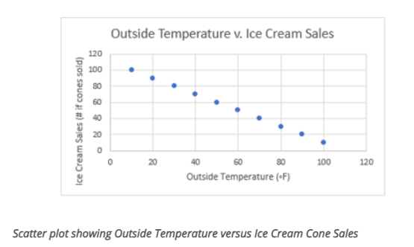
Scatter Plots
When to use:
Paired numerical data
When trying to determine whether two variables are related
Read more: https://study.com/learn/lesson/scatter-plot-diagram-examples.html

Slide 19
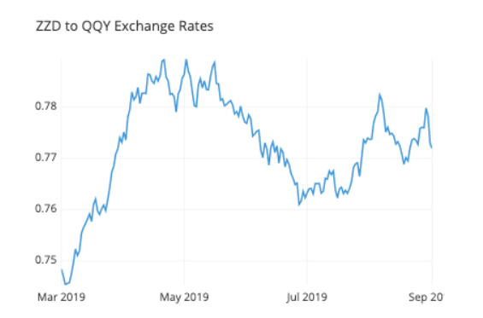
Line Plots
Excellent for tracking changes over a period of time
Read more: https://chartio.com/learn/charts/line-chart-complete-guide/

Slide 20
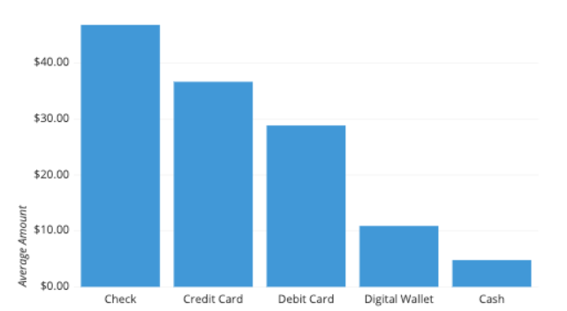
Bar Chart
Used when performing a comparison of metric values across different subgroups of data.
Read more: https://chartio.com/learn/charts/bar-chart-complete-guide/

Slide 21
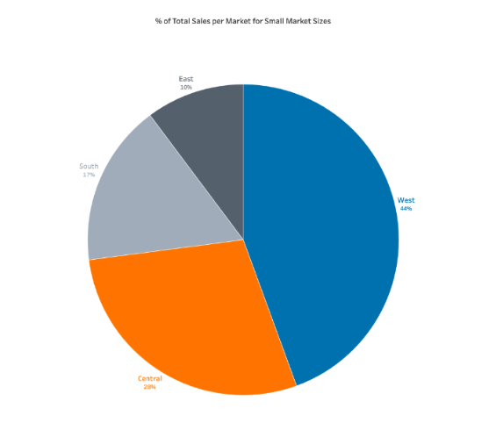
Pie Chart
Used for categorical data
To show distributions of categories as part of a whole
Read more: https://www.storytellingwithdata.com/blog/2020/5/14/what-is-a-pie-chart
Notes:
Be careful when using Pi-charts

Slide 22










Visualization & Presentation tools
Notes:
These and many more. We’ll be using Matplotlib and Plotly in the mini-project.

Slide 23
Questions?

Slide 24
Mini-project
Link to notebook:
https://drive.google.com/drive/folders/1-eG-r4RIxFEh6QvTwlHLS1SQtVVMVBW1?usp=drive_link

Slide 25
Additional Resources
EDA: https://app.datacamp.com/learn/courses/understanding-data-visualization
Data Storytelling: https://elvtr.com/, https://www.youtube.com/watch?v=oVyu-P6f95g

Slide 26
Thank You
Feedback form: Link

